Slide 1





An Overview of Bioinformatics Applications
Fahad Almsned, M.D., Ph.D., M.A.S.
Group Manager, Research and Development, Research Program at E1
Director, Research Operations at KFSH-D
Institutional Review Board (IRB) Chairperson at KFSH-D
Affiliated Graduate Faculty at George Mason University
R&D Consultant and Member of the Board of Advisors at GeneoClinic

Slide 2








Expertise and Career Milestones
A Physician-Scientist focusing on Bio/Clinical/PH Informatics solutions, Precision Medicine, Computational Medicine, and Digital Healthcare Transformation.
M.B.B.S. from King Faisal University, Dammam (2007).
House officer (Psychiatry) at KFHU, KFSH-D, Al-Amal complex, UCSD VA center, and Weiss Memorial Hospital (2007-2015).
ECFMG certificate to practice in the US (2011).
M.A.S. in Clinical Research from UCSD (2013).
Research Associate at George Mason University (2016-2020)
Ph.D. in Bioinformatics and Computational Biology from George Mason University (2020).
Bioinformatics Staff Scientist at National Institutes of Health (NIH) - National Institute of Neurological Disorders & Stroke (NINDS) (2020-2022).
Currently
Group Manager, Research and Development, Research Program (2024-).
Director, Research Operations at RC-KKMC (2022-).
R&D Consultant and Member of the Board of Advisors at GeneoClinic (2023-).
Affiliated Graduate Faculty at George Mason University (2023-)
Institutional Review Board (IRB) Chairperson at KFSH-D (2023-).

Slide 3
What is Bioinformatics?

Slide 4
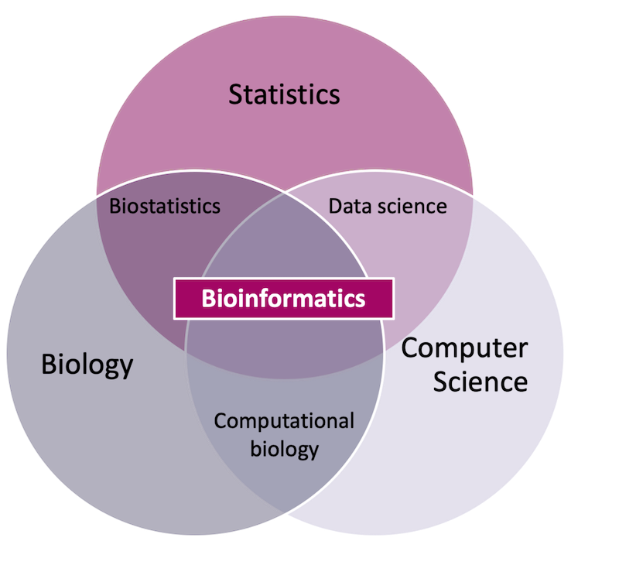
Bioinformatics
According to the NIH, BI is the research, development, or application of computational tools and approaches to expand the use of biological, medical (clinical), behavioral (Psychological and Lifestyle), or health “data,” including those used to acquire, store, organize, archive, analyze, or visualize such data.
Interdisciplinary (biology (Domain), chemistry, physics, computer science, programming, information engineering, mathematics, and statistics).
Source: https://www.precision-analytics.ca/articles/a-primer-on-bioinformatics/

Slide 5
Bioinformatics vs. Computational Biology

Slide 6
Bioinformatics vs. Computational Biology
CB is developing and applying theoretical methods, such as mathematical modeling and computational simulation, to study biological systems (HH).
In summary, while both fields overlap and complement each other, bioinformatics is more data-centric, focusing on tools and methods for data management. In contrast, computational biology is model-centric, focusing on understanding and simulating biological systems.
Source: https://www.precision-analytics.ca/articles/a-primer-on-bioinformatics/

Slide 7
Major Sub-disciplines
BI is a vast field. We have many ways to divide into sub-fields. This is the one I like.
Computing For Biology (Computer Science-oriented Topics) – For Developers
Biology With Computers (Biology-oriented Topics) – For Utilizers
Mathematics For Biology (Math-oriented Topics) – Systems Biology
Biochemistry With Computers (Chemistry-oriented Topics) – MD, 3D modeling
Medicine With Computers (Medically-oriented Topics) – Precision Madine, Clinical Bioinformatics.
Source: https://www.precision-analytics.ca/articles/a-primer-on-bioinformatics/

Slide 8
Computing For Biology (Computer Science-oriented Topics)

Slide 9
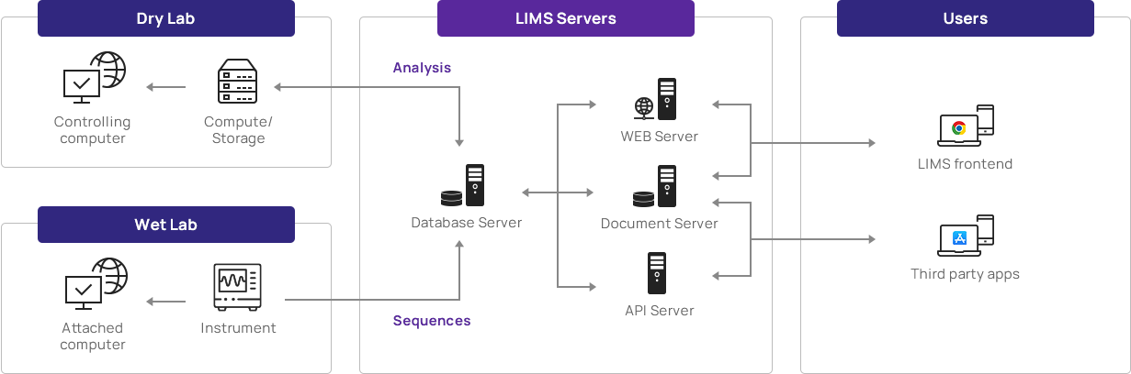
Computing For Biology
Data acquisition
Collecting qualitative and quantitative data from various sources such as EHR, laboratory experiments (LIMS), and medical imaging (e.g., PACS). This process enables data-driven decision-making. (MISO-LIMS)
Source: https://www.theragenbio.com/

Slide 10
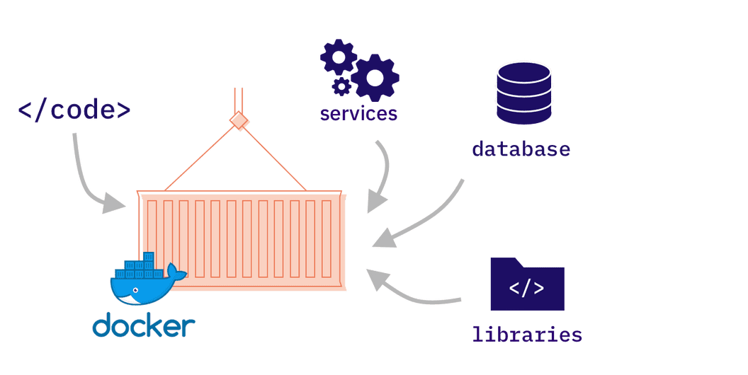
Computing For Biology
Docker
A platform designed to make creating, deploying, and running applications easier using containers.
Containers empower developers to encapsulate an application with all its necessary components, facilitating its distribution as a single, self-contained package.
Launch this container on any server (including the cloud) or a local machine (e.g., developer computer) (Docker)
Source: https://www.marsdevs.com/blogs/what-is-docker-why-is-it-getting-popular

Slide 11
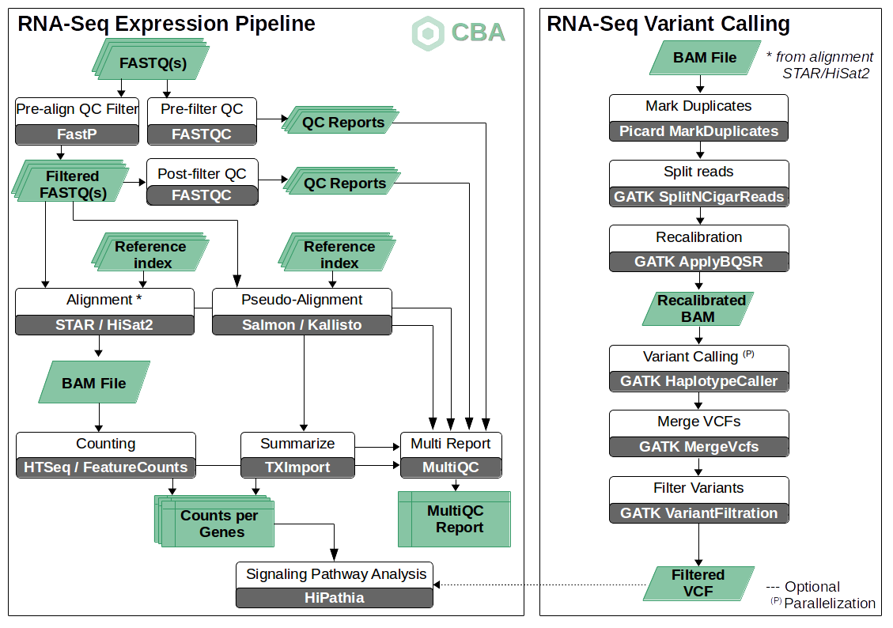
Computing For Biology
Workflow and pipelining
Structured processes facilitate efficient and reproducible results, where sequential, automated, and documented steps are configured to handle data acquisition, processing, analysis, and output generation. (E.g., RNA-Seq Differential Expression vs. Variant Calling).
Source: https://www.clinbioinfosspa.es/content/rna-seq-pipeline

Slide 12
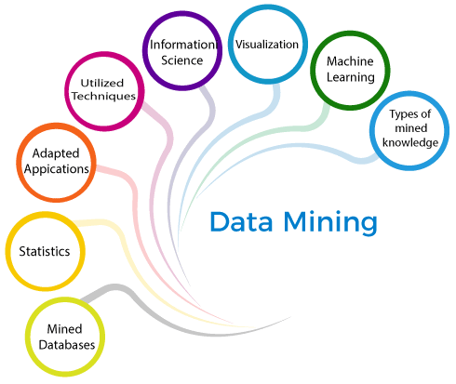
Computing For Biology
Data mining - discovering patterns and extracting valuable insights from large datasets. (e.g., Clustering, Classification, and Anomaly Detection).
Natural language processing - the interactions between computers and human (natural) languages
Data visualization
Source: https://www.clinbioinfosspa.es/content/rna-seq-pipelines

Slide 13
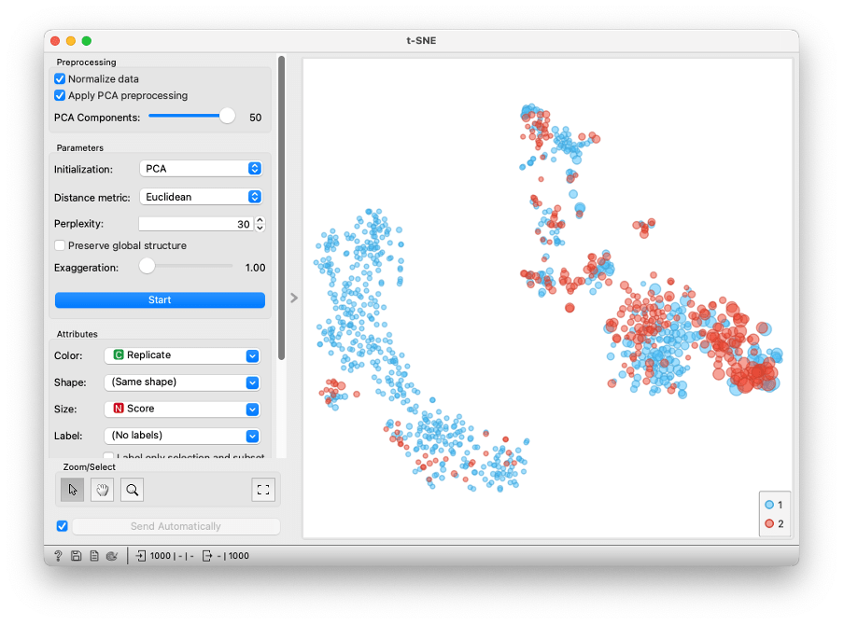
Computing For Biology
Orange 3
Open-source tools for machine learning and data visualization (Free).
Visual Programming (No need for extensive coding skills).
Interactive Data Visualization (Fast).
Supports a variety of Extensions
Source: https://orangedatamining.com/

Slide 14
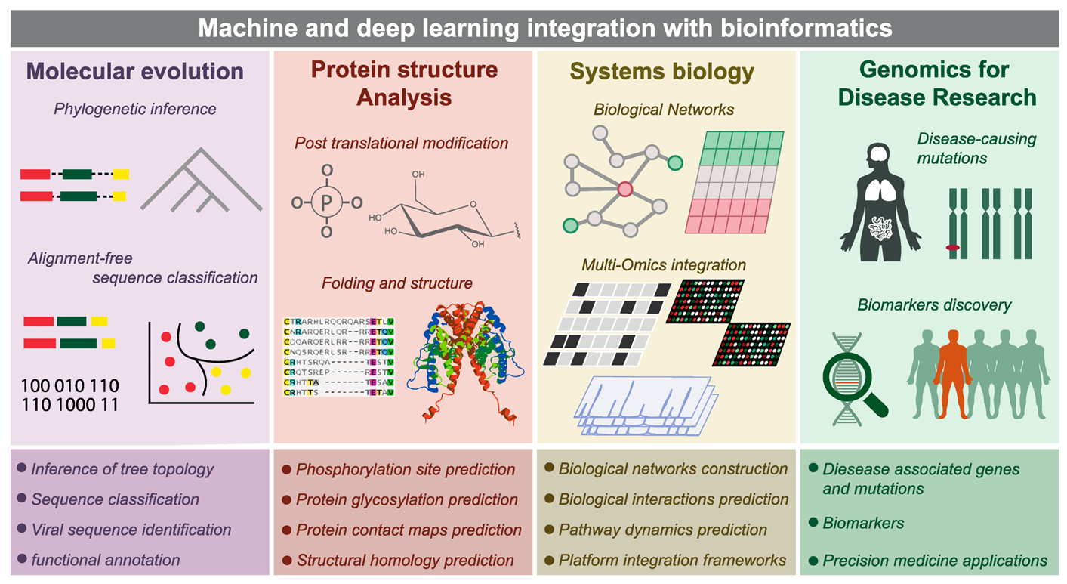
Computing For Biology
Source: https://encyclopedia.pub/entry/48877

Slide 15
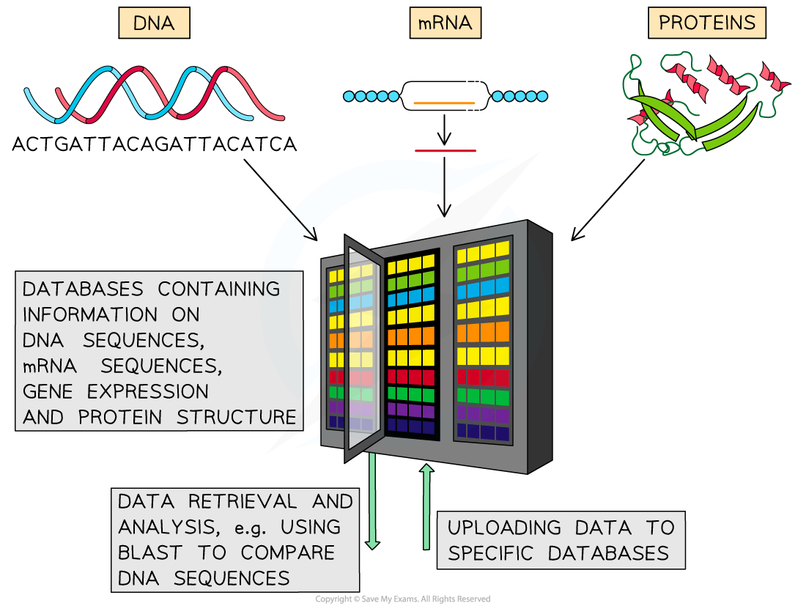
Computing For Biology
Databases and knowledge management
GenBank: A global database of nucleotide sequences (DNA) from various organisms with comprehensive biological annotations.
UniProt: A detailed, curated protein sequence database that integrates and annotates protein information from multiple sources.
dbSNP: A repository for genetic variations, primarily single nucleotide polymorphisms, and small-scale mutations, used in genetic research.
PDB: An archive of three-dimensional structural data of biological molecules, crucial for studying molecular function and processes.
Source: https://www.precision-analytics.ca/articles/a-primer-on-bioinformatics/

Slide 16
Computing For Biology
Databases and knowledge management
UCSC Genome Browser: an online tool that provides a rapid and reliable display of any requested portion of genomes at any scale, along with dozens of aligned annotation tracks (genes, proteins, SNPs, etc.). It is widely used for genomic research, enabling users to visually explore genomic data and annotations.
High-performance computing
Source: https://www.precision-analytics.ca/articles/a-primer-on-bioinformatics/

Slide 17
Biology With Computers (Biology-oriented Topics)

Slide 18
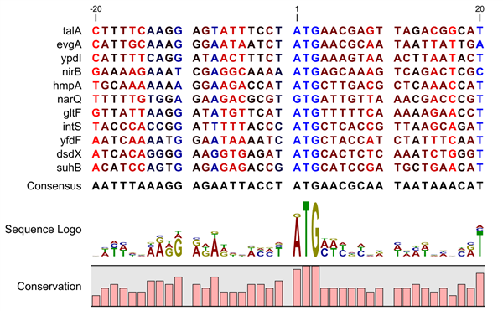
Biology With Computers
Sequence analysis
It involves examining and interpreting biological sequences (DNA, RNA, or protein) to understand their structure, function, and evolution.
It employs computational methods to identify patterns, similarities, and anomalies.
Source: https://resources.qiagenbioinformatics.com/

Slide 19
Biology With Computers
Sequence analysis tools
BLAST (Basic Local Alignment Search Tool): Compares nucleotide or protein sequences to sequence databases and calculates the statistical significance of matches.
Clustal Omega: A tool for multiple sequence alignment that helps in aligning DNA or protein sequences to identify regions of similarity.
Source: https://resources.qiagenbioinformatics.com/

Slide 20
Biology With Computers
Sequence analysis tools
MUSCLE (Multiple Sequence Comparison by Log-Expectation): A multiple sequence alignment program designed for high accuracy in aligning diverse protein sequences.
Bowtie: An ultrafast, memory-efficient tool for aligning sequencing reads to long reference sequences, commonly used in genome-wide analysis.
Source: https://resources.qiagenbioinformatics.com/

Slide 21
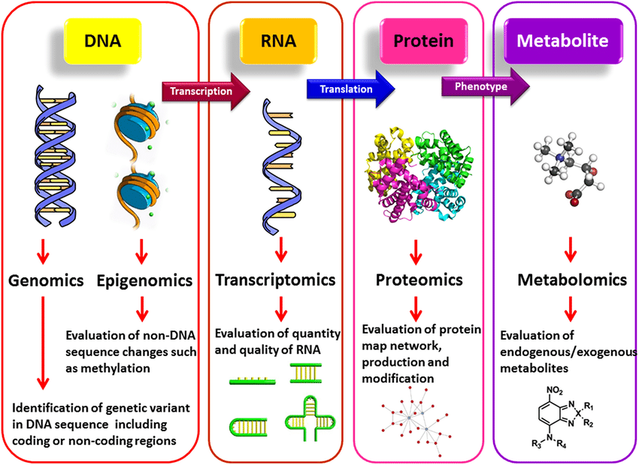
Biology With Computers
-Omics
Genomics: Study of the complete set of DNA (the genome) within a cell of an organism.
Epigenomics: Analysis of the complete set of epigenetic modifications on a cell’s genetic material.
Transcriptomics: Analysis of the complete set of RNA transcripts produced by the genome.
Proteomics: Study the entire set of proteins within a cell or organism, including their modifications and interactions.
Source: https://www.researchgate.net/publication/350668866_New_diagnostic_molecular_markers_and_biomarkers_in_odontogenic_tumors

Slide 22
Biology With Computers
-Omics
Metabolomics: Study the complete set of metabolites and small molecule substrates/products of metabolic reactions in a biological specimen.
Microbiomics: Study of the microorganisms in a particular environment, including their genomes.
Pharmacogenomics: Study of how genes affect a person's response to drugs, aiming to develop rational means to optimize drug therapy.
Source: https://www.researchgate.net/publication/350668866_New_diagnostic_molecular_markers_and_biomarkers_in_odontogenic_tumors

Slide 23
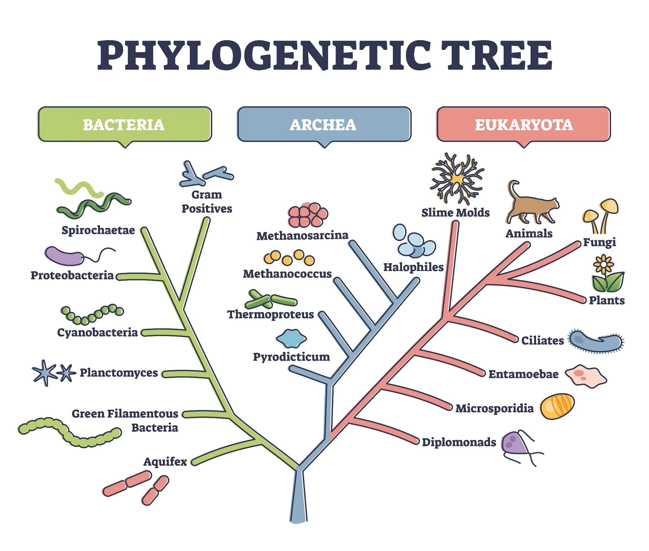
Biology With Computers
Phylogenetics - the study of the evolutionary history and relationships among individuals or groups of organisms (e.g., species or populations). (NCBI) (https://phylot.biobyte.de/)
Utilizes genetic data, such as DNA sequences, to reconstruct evolutionary trees (phylogenies) and examine how species are related through common ancestry.
Helps understand the patterns of evolution, biodiversity, and the transmission of diseases.
Source: https://www.azolifesciences.com/article/What-is-Molecular-Phylogenetics.aspx

Slide 24
Mathematics For Biology (Math-oriented Topics)

Slide 25
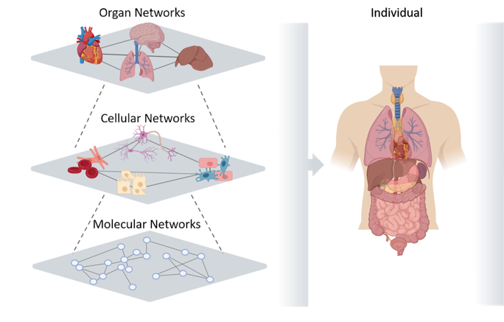
Mathematics For Biology
Systems Biology
Focuses on the complex interactions within biological systems, aiming to understand and model them comprehensively ( putting its pieces together).
Combines experimental and computational methods to study the relationships and dynamics between various biological components such as genes, proteins, and metabolic pathways.
Insights into the behavior of entire biological networks, predict system responses to changes, and ultimately improve understanding of diseases and their treatments.
Source: https://www.creative-proteomics.com/services/protein-structure-analysis-service.htm

Slide 26
Biochemistry With Computers (Chemistry-oriented Topics)

Slide 27
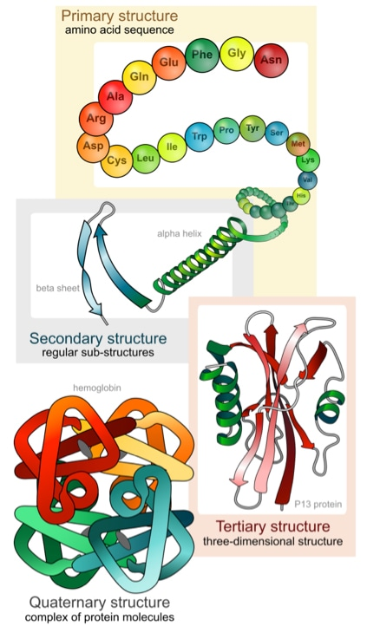
Biochemistry With Computers
Protein Structure Analysis
Study of the 3D arrangement of atoms within a protein.
Crucial for understanding its function and interaction with other molecules.
Techniques such as X-ray crystallography, NMR spectroscopy, and cryo-electron microscopy are commonly used to determine structures (PDB)
Source: https://www.creative-proteomics.com/services/protein-structure-analysis-service.htm

Slide 28
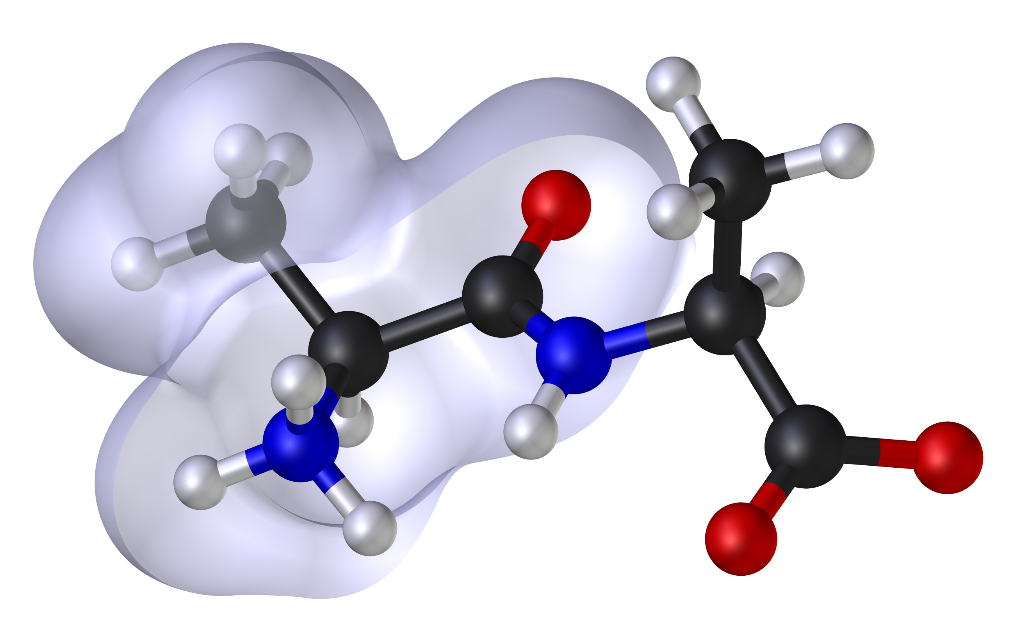
Biochemistry With Computers
Molecular Modeling
A broad field encompasses various computational techniques used to visualize, simulate, and analyze the structures and functions of molecules, especially large biological macromolecules like proteins, DNA, and RNA.
Techniques include energy minimization, molecular dynamics, docking studies, and quantum mechanics.
Source: https://commons.wikimedia.org/wiki/File:Molecular_Modeling.png

Slide 29
Biochemistry With Computers
Molecular Modeling
Help predict molecular structures, understand chemical properties, and design drugs by simulating interactions between molecules and their environments.
Molecular modeling is crucial in drug design and the understanding of disease mechanisms at the molecular level.
Source: https://commons.wikimedia.org/wiki/File:Molecular_Modeling.png

Slide 30
Biochemistry With Computers
Molecular Modeling
Computational tools like molecular dynamics simulations, homology modeling, and structure visualization software (e.g., PyMOL and Chimera) are vital for analyzing and interpreting protein structures. This analysis helps in drug design, understanding disease mechanisms, and engineering enzymes.
Source: https://commons.wikimedia.org/wiki/File:Molecular_Modeling.png

Slide 31



Together for a healthier world
Thank you!
Almsned.fahad@gmail.com
https://twitter.com/Fahad_Almsned
https://www.linkedin.com/in/fahad-almsned
Notes:
Thank you so much for your time!
Here are my email address and my Twitter and LinkedIn accounts. Please do not hesitate to contact me If you have any questions.
Thanks again!

